Slide 1
Modernize your Existing Apps for Windows 10
Notes:
DEMOS: https://github.com/Microsoft/InsiderDevTour18-Modernize
Welcome…​
​
In this session we are going to explain WHY and HOW you can MODERNIZE your existing desktop apps.​

Slide 2
A modern platform for Desktop developers
Desktop
Modern
Desktop Application
Modern Application
Secure and trusted environment
UX and features
Cloud and client portability
Notes:
Over the past couple of years we have been building a MODERN APP MODEL that bring benefits such as CONTAINERIZATION, MODERN UI and CODE PORTABILITY.

Slide 3
A modern platform for Desktop developers
Desktop
Modern
Desktop Application
Modern Application
Secure and trusted environment
UX and features
Cloud and client portability
Notes:
Windows is making it easier than ever to move forward your WPF / WINFORMS / WIN32 apps and experiences REGARDLESS OF THE APP MODEL or UI FRAMEWORK you are using.

Slide 4
Modern packaging
Simple packaging
Secure and reliable
Trusted distribution
Declarative manifest file
Identity, formal versioning, device targeting
Signed packages
Contained execution
Clean uninstall
Platform managed updates
Flexible distribution – your website, xcopy, Store, SCCM, …
Notes:
Windows 10 provides a lot of capabilities to help make your apps safe and reliable. Let’s get started by talking about our investments in a modern packaging system for IT PROS and DEVELOPERS.
Here are some of the KEY AREAS FEEDBACK WE HEAR FROM DEVELOPERS for of a MODERN PACKAGING SYSTEM.
SIMPLE PACKAGING – open, declarative, and self contained.
SECURE AND RELIABLE – your package executes in a secure container. Your app cleanly uninstalls eliminating machine rot.
TRUSTED DISTRIBUTION – the platform manages updates, and you can choose how you want to distribute.

Slide 5

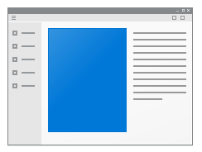


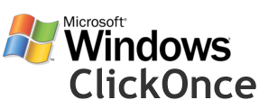







Setup.exe
MSI
MSIX
script.vbs
Notes:
There are numerous INSTALLER TECHNOLOGIES out there today and they do not address ALL of the requirements just described. MSIX is our OPEN SOURCE approach to solving this problem.
This is not just about Microsoft – we have MANY INSTALLER PARTNERS onboard.
MSIX is our evolution of APPX and the Desktop Bridge. And this is not just WINDOWS 10, we also support WINDOWS 7 (without Windows 10 API support).
Lets take a look at how to package a Desktop app today.

Slide 6
Demo!
Packaging your desktop app

Slide 7
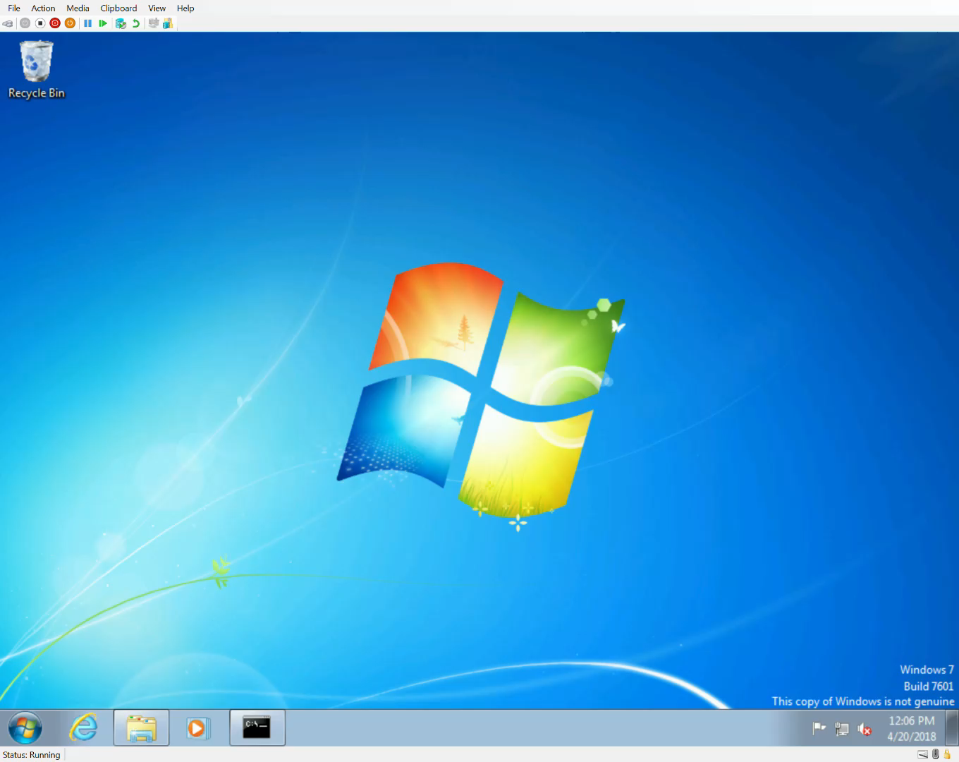
Notes:
We heard strong feedback that you want to MOVE FORWARD but you need to SUPPORT YOUR WINDOWS 7 userbase. Because MSIX is open source, it can be used on Mac, Linux, and of course WINDOWS 7.
Windows 10 is where you will get the benefits such as CONTAINERIZATION, WINDOWS 10 API access, and UPDATE MANAGEMENT, but this PROTOTYPE shows you can use a common build system for a Windows 7 app.

Slide 8
Demo!
Modern UX – example: WebView
Notes:
We just saw how to package your desktop app – this brings an additional advantage of giving your app an identity – this gives you access to the BROADEST POSSIBLE RANGE of Windows 10 APIs. Let’s start by taking a look at how you can introduce a modern UX into your app.
One of the top pieces of feedback we heard from the DESKTOP DEVELOPER COMMUNITY was for a modern web browser control – I am pleased to announce that this is now available – let’s take a look.

Slide 9
ROADMAP | UWP XAML Island Architecture
Control Wrappers
Custom Controls
OSS Projects
Your Code
App Code
UWP XAML Host - WPF
UWP XAML Host - WinForm
HWND
XAML Bridge Source WinRT API
HWND
Platform
UWP XAML Control
Notes:
What you have just seen is an example of what we’re calling a XAML ISLAND – that is, hosting XAML CONTROL content in a different UI FRAMEWORK such as WINFORMS or WPF.
Adding UWP XAML to your desktop apps is possible today, but you need to host these in a separate window. With UWP XAML islands, we are making it possible to EMBED MODERN CONTROLS inside of your existing UI.
In this diagram you can see the XAML Bridge Source that enables this functionality through exposing a HWND many of you will be familiar with.
We will be OPEN SOURCING XAML Hosts that will leverage the bridge to support UWP XAML in both WinForms and WPF.
Control wrappers can then consume these hosts so you can embed the controls inside your Desktop apps.

Slide 10
ROADMAP | UWP XAML Island Wrappers
Control Wrappers
OSS Projects
App Code
UWP XAML Host - WPF
UWP XAML Host - WinForm
Windows Forms & WPF tuned wrappers for the most requested controls
Designing fallback support so apps can use one binary on Win10 and Win7
We will begin adding these wrappers between now and next Windows update
Notes:
We started by building XAML hosts for both WPF and WINFORMS as these were the UI frameworks where we were seeing the biggest DEMAND.
We’re building fallback support so your apps can use ONE BINARY on both WIN10 & WIN7.
We will begin by adding control wrappers between now and the next Windows update – we’re looking at FLUENT, INKING and OTHERS - LET US KNOW WHICH ONES YOU’D LIKE TO SEE!

Slide 11


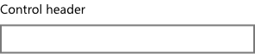
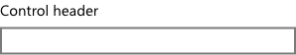
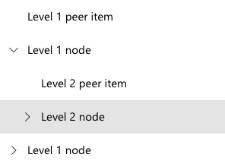

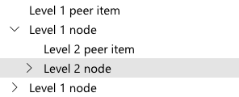

ROADMAP | UI Density
Today
New Microsoft Standard
New Compact Size
Notes:
Another KEY PIECE OF FEEDBACK we heard from DESKTOP DEVELOPERS is that your scenarios require a DENSE UI. As you start to bring UWP XAML controls into your app, we want to support the density you are used to.
Here you can see an example of how a set of common controls render today. In the next version of Windows we will support a new denser Microsoft Standard that continues to support multiple modalities such as Touch. And if you need to be optimized for KEYBOARD AND MOUSE, we also have a new compact size for you.
Let’s take a look at some of the experiences a MODERN UX brings…

Slide 12
Demo!
Modern features – example: Windows Hello
Notes:
You may want to keep your existing UI and THAT IS OK - you can still take advantage of Windows 10 APIs – let’s take a look how…
Here we are showing an example of how to call a Windows 10 API – in this case “Windows Hello” to introduce SECURITY BENEFITS to your desktop app.
This same approach can be used for leveraging a large number of WINDOWS 10 APIs, such as integration into toast notifications, contacts and people, and share source & target, ...

Slide 13





.NET Core
3 (coming next year)
2
Why Windows Desktop on .NET Core?
Side by side
Machine global or app local framework
Core runtime and API improvements
New .csproj project system
.NET Core is perfectly suited for the requirements of cloud-native, cross-platform workloads
WEB
CLOUD
AI
IoT
DESKTOP
.NET CORE
.NET CORE 3
LIBRARIES
INFRASTRUCTURE
RUNTIME COMPONENTS
COMPILERS
LANGUAGES
Notes:
As developers, we want to ensure our code PERFORMS WELL, is PORTABLE, and is MAINTABLE.
With .NET Core 3 we are bringing support to new device types including AI, IOT, and DESKTOP.
.NET CORE for DESKTOP means you NO LONGER need a DEPENDENCY on the .NET FRAMEWORK installed on the machine – you ship what you need.
.NET CORE has a smaller footprint and IMPROVED PERFORMANCE. .NET CORE also supports a more MODERN .csproj PROJECT SYSTEM.

Slide 14
.NET Core 3 Desktop Improvements
.NET Core 3 supports WinForms and WPF frameworks
XAML Controls – WinForms & WPF browser and media UWP controls
XAML Islands - WinForms & WPF can host UWP
High DPI fixes for WinForms
.NET Core support for all the Windows 10 API’s
.NET Core App Bundler
Precompiled, fast startup
Small apps by removing unused dependencies, link away unused IL
Single self-contained .EXE
Notes:
You will get to MAXIMIZE CODE RE-USE across all of these DEVICE TYPES and we will SUPPORT WINFORMS and WPF controls and XAML ISLANDS.
You will have access to ALL WINDOWS 10 APIS and .NET CORE TOOLING that will bring you that IMPROVED PERFORMANCE.

Slide 15
Demo!
Modern command-line
Notes:
After all of this UI goodness, we know why you’re really here… THE COMMAND LINE! Here are some new features just for you…

Slide 16
aka.ms/insiderdevtour-labs
Learn how to package your app
Learn how to modernize your UX
Learn how to add new Windows 10 APIs
Notes:
Thank you! To try out some of these new features yourself in our HANDS-ON LABS!

